Slide 1

Real Estate Property Management System
EstateEdge
A Real Estate Website

Slide 2

TEAM MEMBERS
Srabonti Suchi Talukdar
Allo Rani Malakar
Rashada Chowdhury

Slide 3
Course Code: CSE-334 Course Title: Software Engineering Department: CSE,6th semester
Submitted To:
Sabuj Chandra Paul
Sr. Software Engineer &Guest Lecturer at NEUB

Slide 4

Why This Project:
The primary purpose of this system is to provide a comprehensive and user-friendly platform where:
• Customers can explore property listings, save favorites, chat with agents, and receive support.
• Agents can manage their profiles, respond to inquiries, and track listing performance.
• Administrators can oversee users, monitor activities, manage recruitment, and maintain platform integrity.

Slide 5

Features
User
Users can save properties
Users can Message
Agents
Live Chat (AI)
Agent
Agents can make
Post
Agents can update listings
Admin
Admin can approve posts
Admin can
manage all posts
USER ROLES:
Public User
Agent
Admin

Slide 6
Technologies Used:
FRONTEND: React.js
BACKEND: Node.js, Express.js
DATABASE: Prisma with MongoDB
AUTHNICATION: JWT

Slide 7
CONTRIBUTIONS
Srabonti Suchi Talukdar
Allo Rani Malakar
Rashada Chowdhury
Admin Panel
Pie Chart
Filter Features
Testing
Backend
API (Post & Save)
Prisma Setup
Testing
Frontend UI
Card Components
Agent Functions
Testing

Slide 8
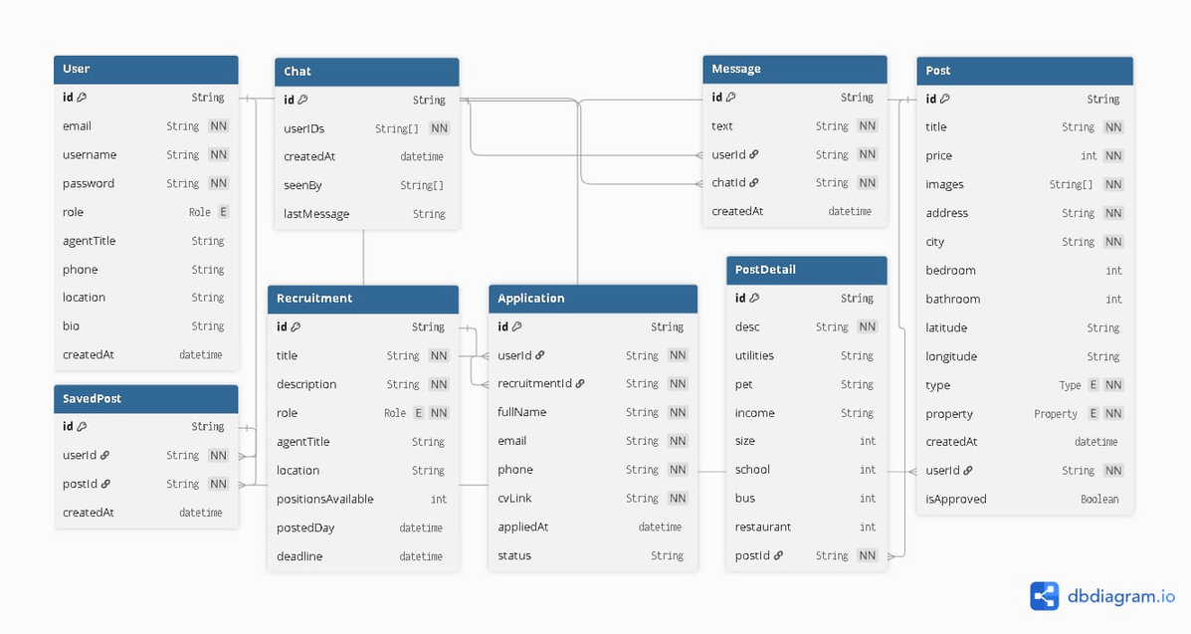
ERD (Entity-Relationship Diagram):
Visual Representation of Data Structure
Entities and Attributes
Relationships Between Entities
Primary and Foreign Keys
Database Design Foundation

Slide 9
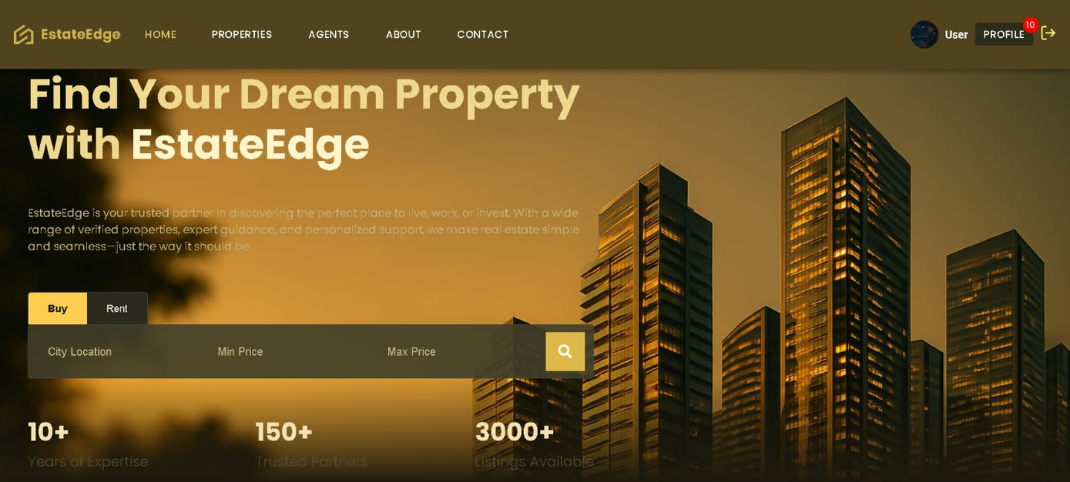
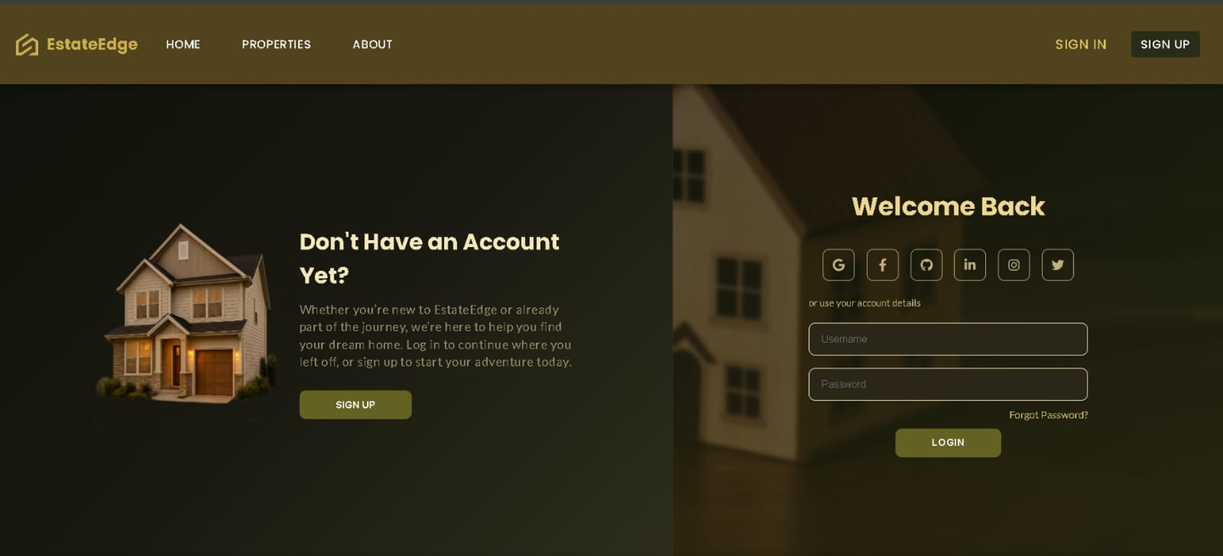
HomePage and SignUp
-Intuitive Property Search
-Extensive Property List
-Expert guidance & Trusted Partner
-Simplified and Seamless
-Quick and hassle free Sign Up Process
-Convenient Login options

Slide 10
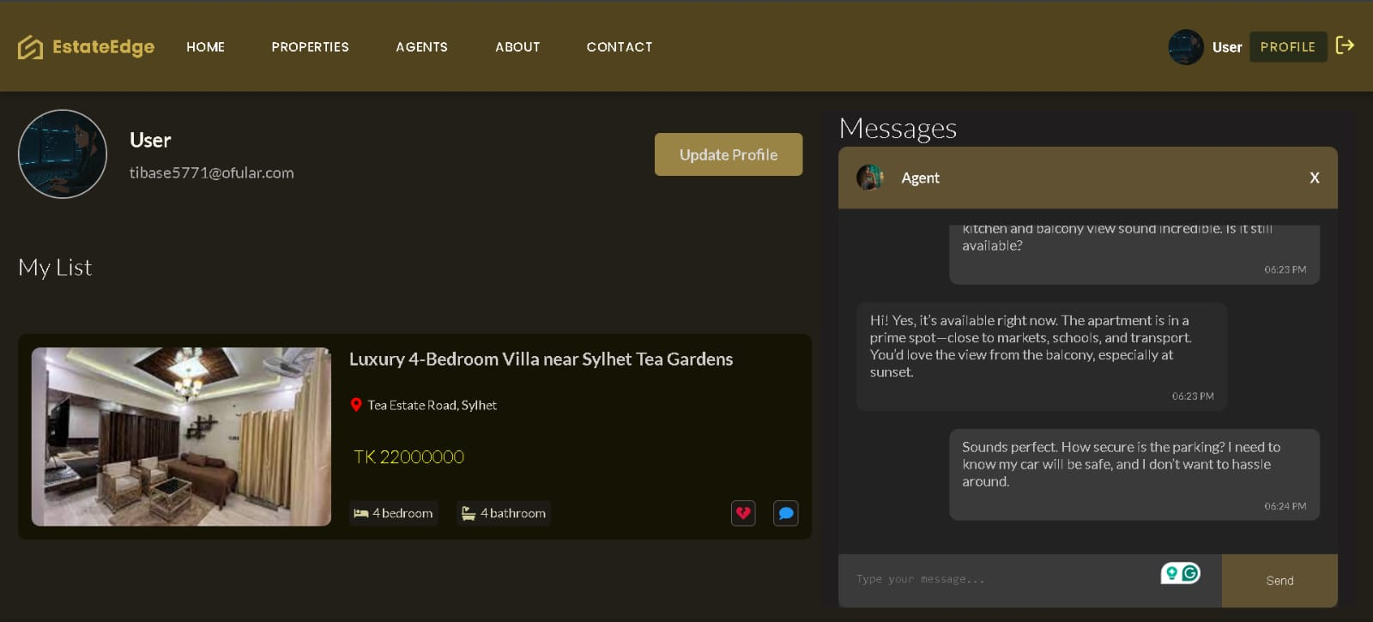
User Profile
-User Profile Mangement
-My List for saved properties
-Direct Messaging with agents

Slide 11
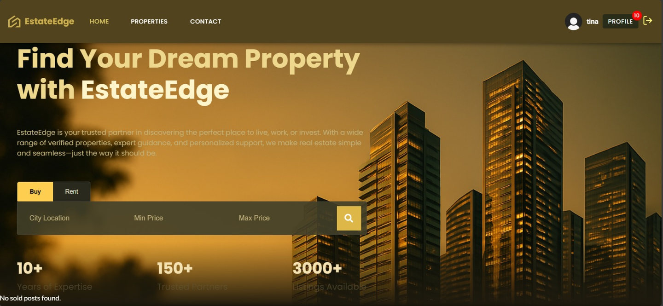
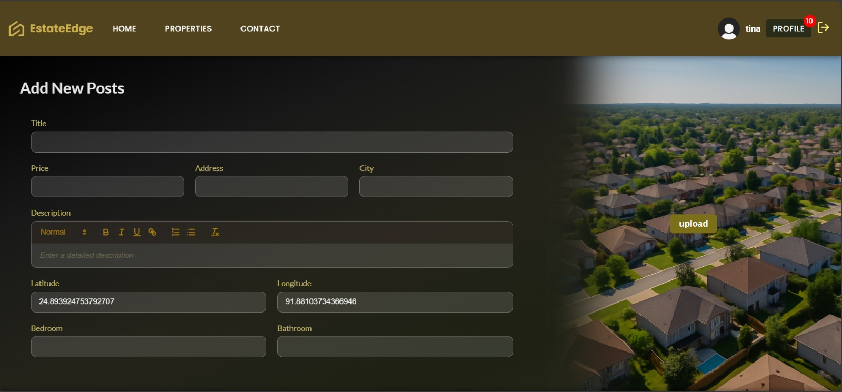
Real Estate Agents
• Post properties (subject to admin approval)
• Edit, delete, or mark properties as sold
• Respond to user messages
• Apply for recruitment (admin-level roles)
• Update personal profile
• Contact administrators via email

Slide 12
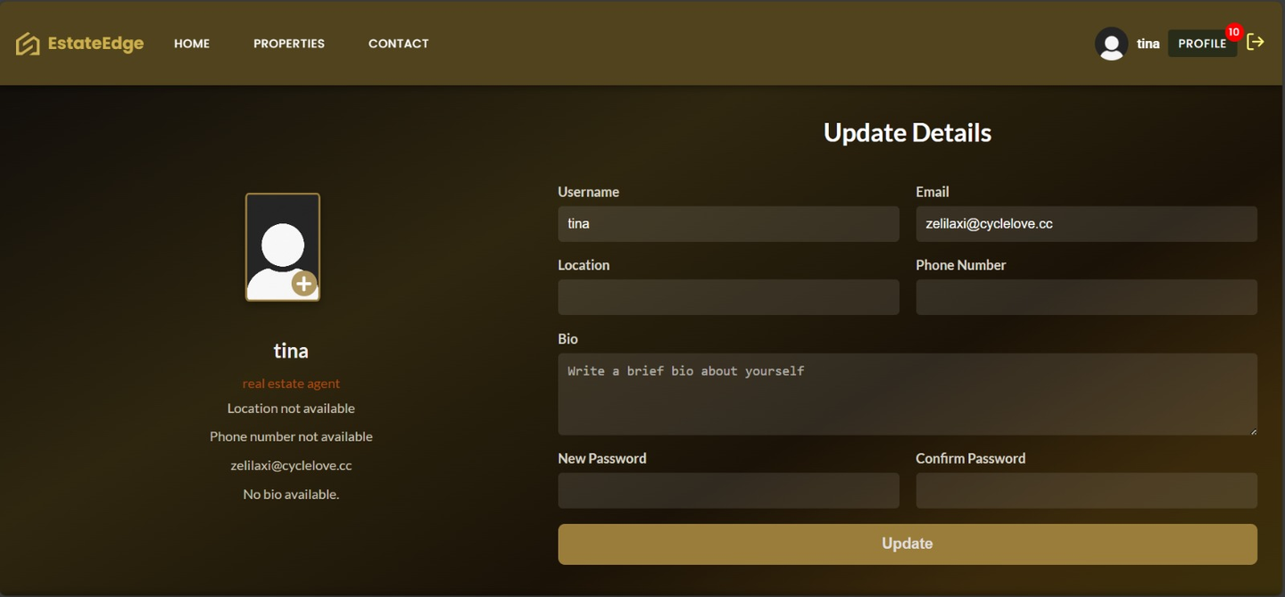
Agent Profile
-Agent Profile Mangement
-Direct Messaging with Users
-Update profile informations

Slide 13
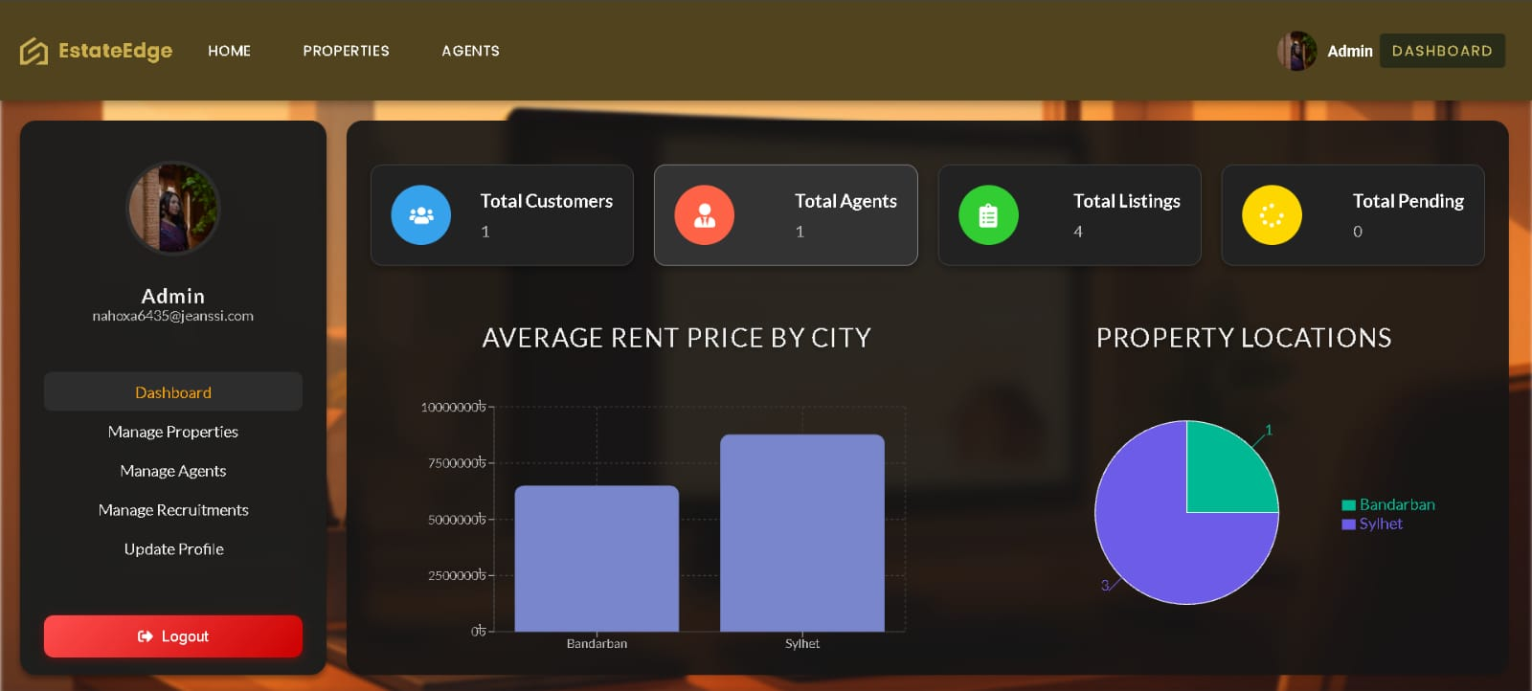
Admin Control Centre
• Access dynamic dashboard with user, post, and agent insights
• Approve, edit, inactive, or mark any property
• Change agent roles and permissions
• Deactivate or reactivate agents
• Manage recruitment posts and applicant approval

Slide 14
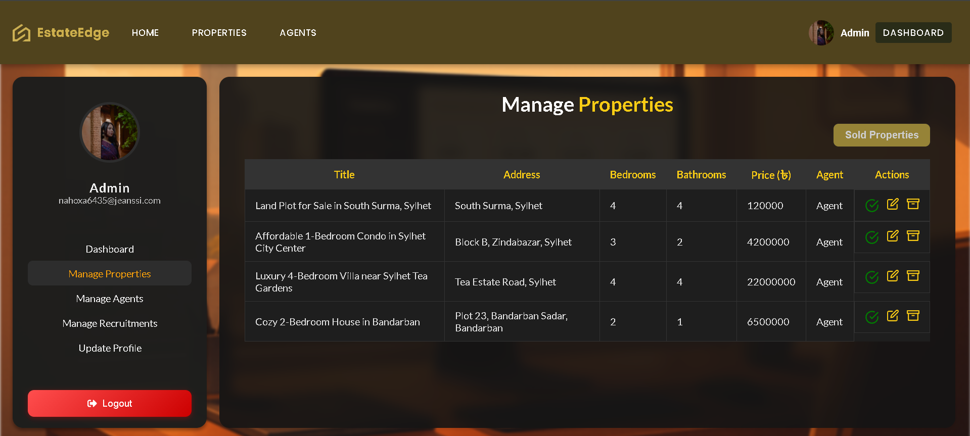
Efficient Listing Control
• Centralize property list
• Essential Details Display
• Direct action capabilities
• Deactivate or reactivate agents
• Approve | Verify | Edit | Inactive
• Ensuring Data Integrity

Slide 15
CONCLUSION
This project demonstrates the successful development of a full-stack real estate web platform that combines user interaction, data management, and administrative control using role-based access. The use of the Rapid Application Development (RAD) model enabled efficient prototyping and continuous iteration. Features like real-time chat, dynamic dashboards, and intelligent support systems contribute to a platform that is both user-friendly and scalable.

Slide 16
Thank You

